Slide 1
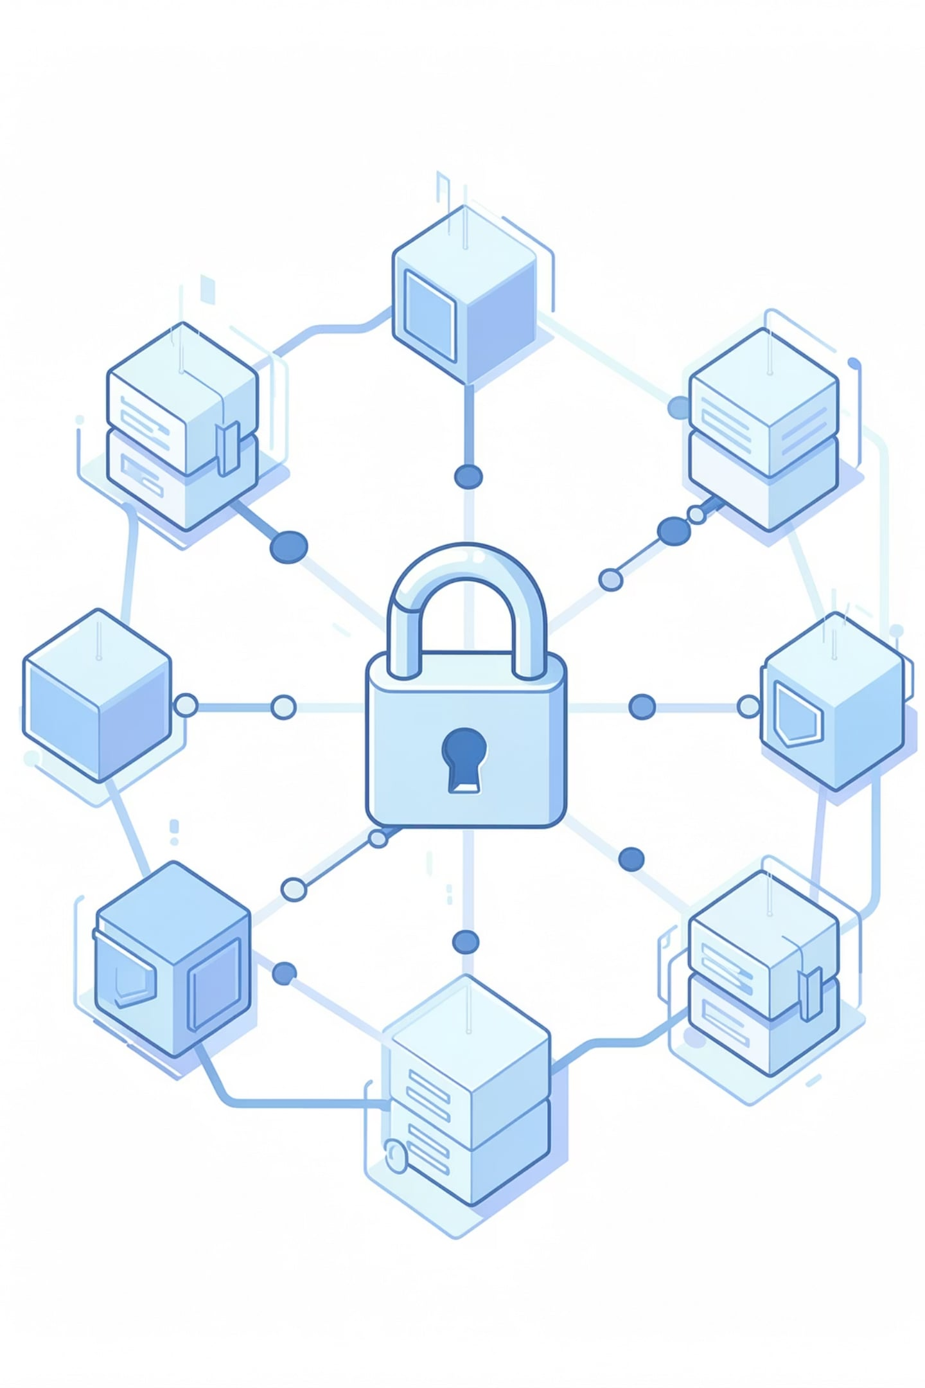
Blockchain-Based Digital Document Locker
A decentralized, tamper-proof alternative to centralized document storage systems.
Contributors
SHAH EMANUL HAQUE (25BCE1463)

Slide 2
What is DigiLocker?
DigiLocker is a Government of India platform for storing and sharing official documents digitally.
Key Features of DigiLocker:
Cloud storage
Digital signatures
Government integration
Store documents securely online.
Sign documents electronically.
Connect with official agencies.
Fast sharing
Paperless
Share verified documents instantly.
Reduce physical paperwork.

Slide 3
DigiLocker - Advantages & Limitations
ADVANTAGES
LIMITATIONS
Legally recognized
Single point of failure
Official and trusted.
Centralized architecture.
Less paperwork
Security risks
Faster, simpler workflows.
3.68 crore accounts risk.
Access anywhere
Privacy concerns
Use it on any device.
Aadhar dependency.
Govt. database sync
Limited transparency
Easy document availability.
No data sovereignty.
Cost-effective
Forgery risk
Saves printing and storage costs.
Documents can still be tampered with.

Slide 4
Introduction to Blockchain Technology
Blockchain is a shared digital ledger spread across many computers. It strengthens document security by improving trust, traceability, and resistance to tampering.
Core Characteristics & Key Features for Document Security:
1
Decentralized
2
Immutable
3
Transparent
4
Secure
5
Consensus-based
6
Hashing
7
Distributed storage
8
Immutable ledger
9
Audit trail
10
Digital signatures

Slide 5
Blockchain Features - Tamper-Proof, Immutable & Secure
TAMPER-PROOF MECHANISM
IMMUTABILITY
SECURITY FEATURES
Read-only records
Persistent timestamps
Permanent audit trail
Data encryption
Digital signatures
Decentralized protection
Hash detection
Chain integrity
Consensus protection

Slide 6
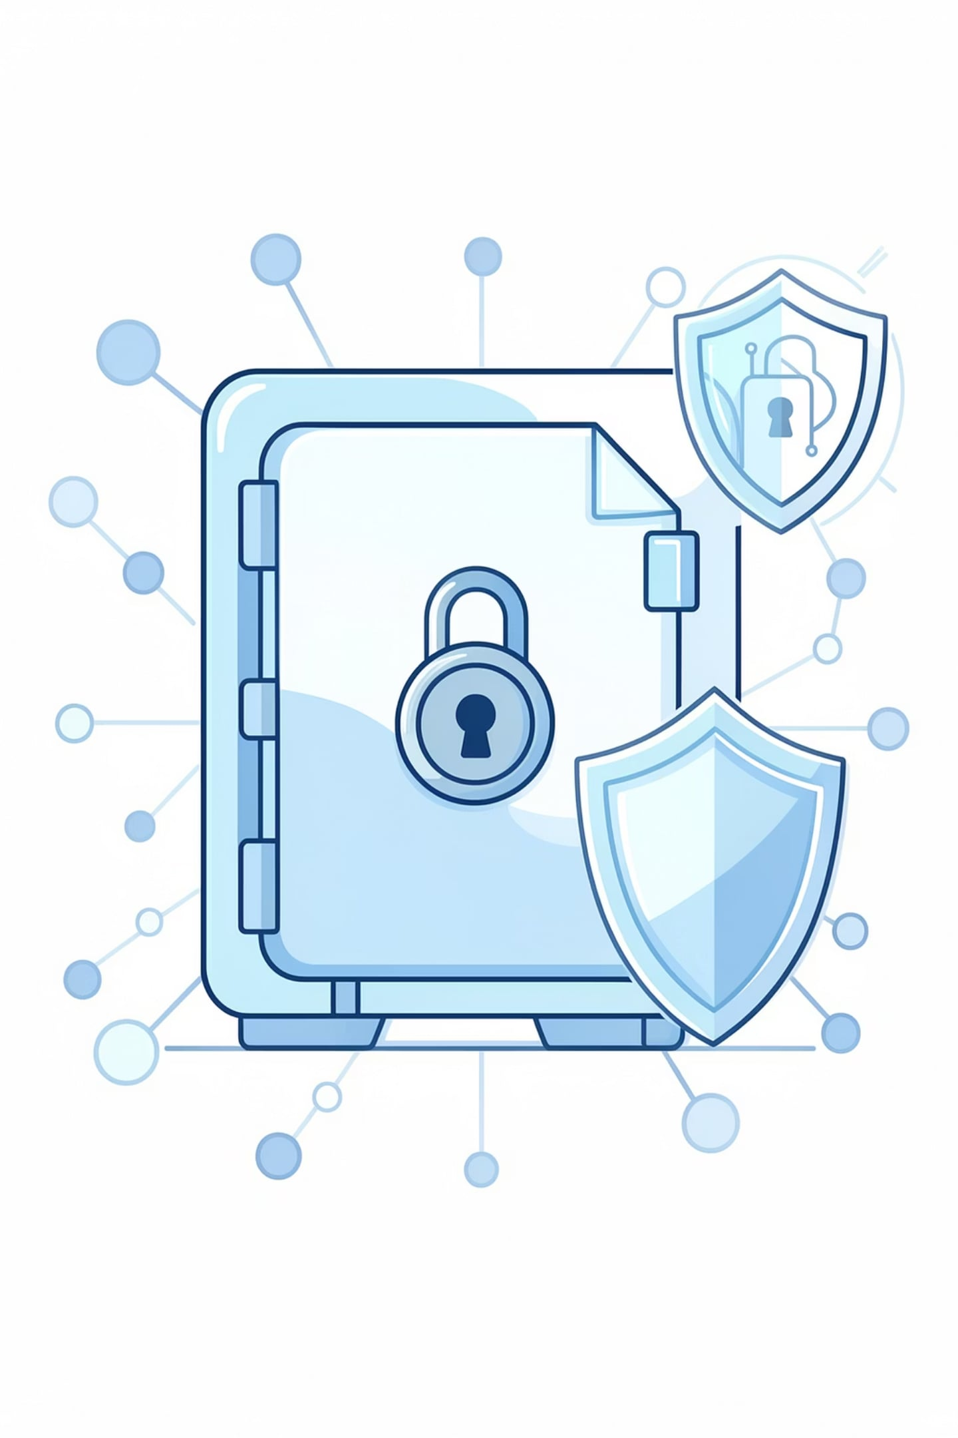
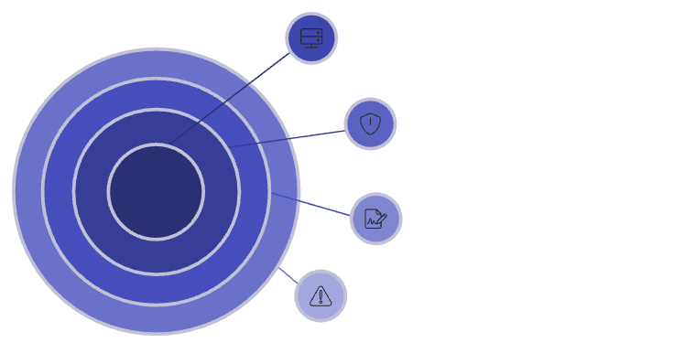
Problem Statement: DigiLocker Vulnerabilities
Vulnerability Pipeline
Core Storage & Verification Deficiencies
Centralized storage
Potential single point of failure.
Breach risk
Vulnerability to unauthorized access.
Single Point of Failure
Document Tampering Risk
Government Control
Slow Verification
No Immutable Proof
Forgery risk
Possibility of document falsification.
System dependency
Reliance on external systems.

Slide 7
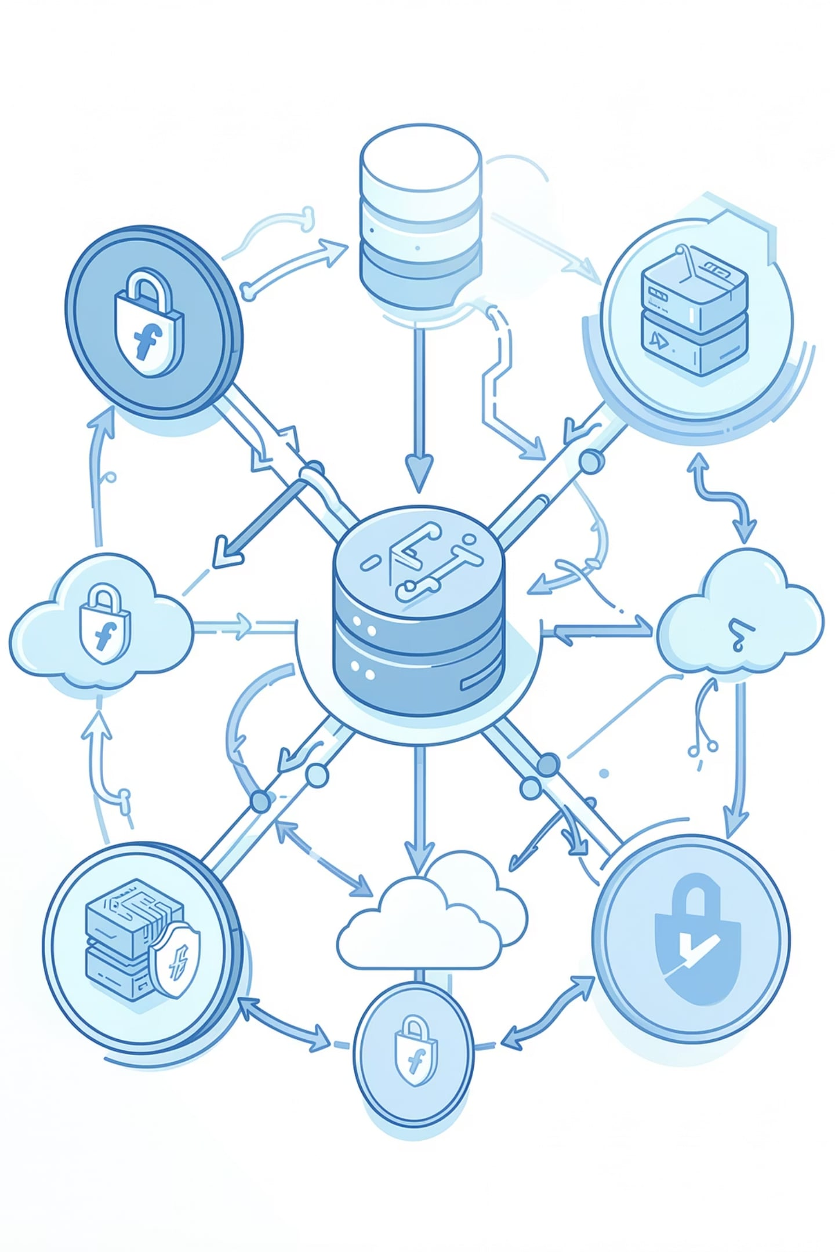
Proposed Solution: Blockchain-Based Digital Document Locker
A secure decentralized document locker.
Key Solution Features
Decentralized Architecture
Cryptographic Verification
Distributed storage
SHA-256 hashing
Immutable Records
User Ownership
Permanent proof
Private keys
Instant Verification
Privacy-First
Instant checks
Client-side encryption

Slide 8
Blockchain vs Traditional DigiLocker
A concise comparison of security, control, and efficiency.
ASPECT
TRADITIONAL DIGILOCKER
BLOCKCHAIN-BASED SOLUTION
Architecture
Centralized server
Distributed network
Data Control
Government-managed
User-controlled keys
Tamper Resistance
Vulnerable
Hash-protected
Verification Speed
Hours to days
Milliseconds
Audit Trail
Editable logs
Immutable ledger
Single Point of Failure
Yes
No

Slide 9
System Architecture
Blockchain Layer
Application Layer (Backend)
Ethereum smart contracts
Immutable audit log
Presentation Layer (Frontend)
Node.js API gateway
AES-256-GCM encryption
N.js + Tailwind
Web3 wallet access
Verification & Audit Layer
Decentralized Storage
Hash checks
Revocation checks
IPFS cluster
Encrypted replication

Slide 10
Technical Layer Breakdown
Frontend Layer
Smart Contract Layer
Storage Layer
Next.js + Ethers.js. MetaMask ready.
Solidity contracts on Ethereum.
Encrypted files pinned on IPFS.

Slide 11
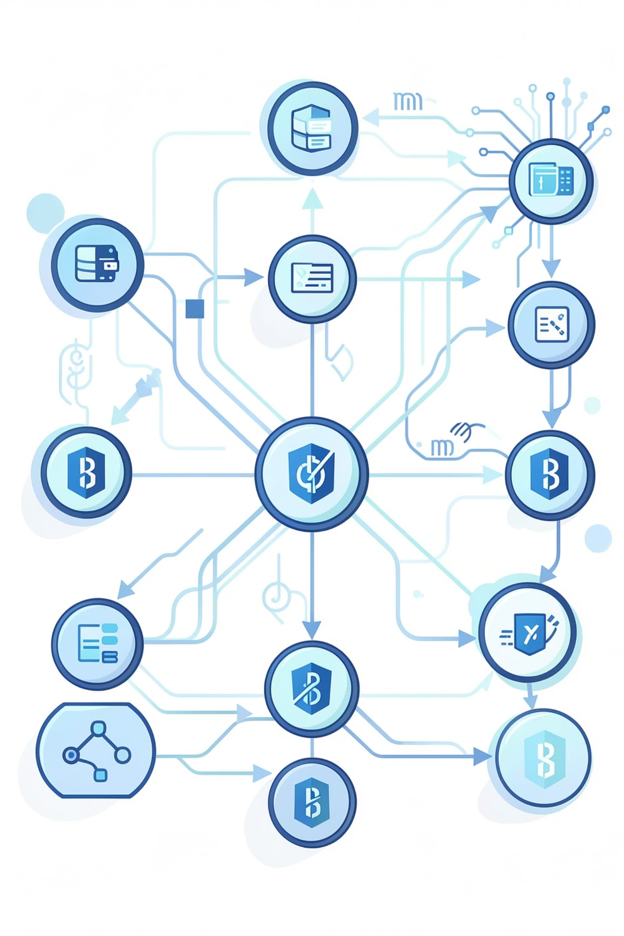





Working Process & Execution Workflow
Phase 1: Upload, Encryption & Storage
User Authentication
Web3 login
Client-Side Encryption
AES-256 encryption
IPFS Pinning
IPFS pinning
Smart Contract Registry
On-chain storage
Phase 2: Retrieval & Verification
Authorized Access
Access request
Zero-Knowledge Hash Verification
Hash verification

Slide 12
Multi-Layer Security Model
Our blockchain document locker protects confidentiality, integrity, and availability across multiple security layers.
Security Layer
Technology
Function
Data At Rest
AES-256-GCM
File encryption
Data Integrity
SHA-256 Hashing
Change detection
Access Control
Smart Contracts
Access management
Immutable Audit
Ethereum Blockchain
Permanent records
Identity Verification
Web3 Wallet Signatures
Cryptographic authentication
Fault Tolerance
IPFS Network
Distributed storage

Slide 13
Comparative Analysis & System Advantages
Feature Metrics
Traditional
Blockchain
Data Ownership
Centralized control
User-owned keys
Tamper Resistance
Modifiable
Immutable by consensus
System Uptime
Single-point failure
Decentralized resilience
Verification Speed
Hours or days
Under 2 seconds
Audit Trail
Editable logs
Immutable ledger
Fraud Prevention
Duplicate-prone
Hash-verified
Strategic System Benefits
1
Fake Credentials Blocked
2
Instant Verification
3
Privacy First
Cryptographic checks stop forgeries.
No manual delays.
Users control access.

Slide 14
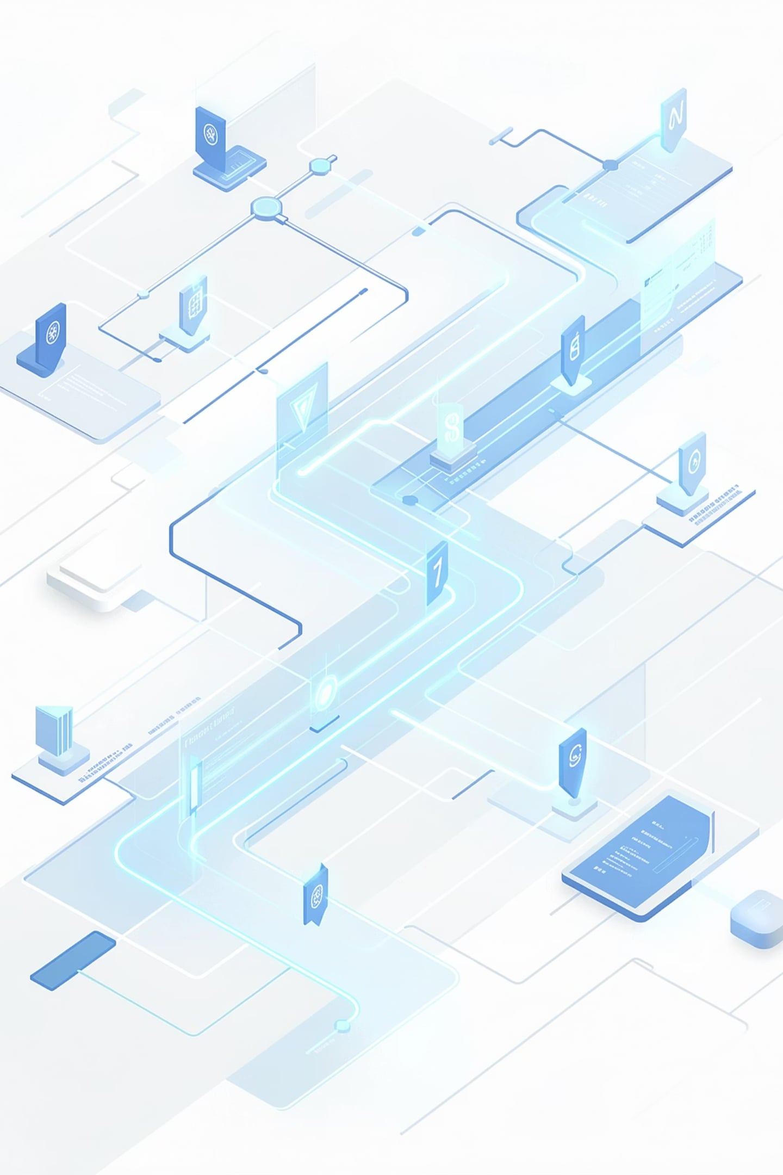
Future Scope & Roadmap
Our roadmap highlights the next key platform milestones.
Q3: Milestone 1
Q1: Milestone 3
Mobile app
FIDO2 auth
Institutional API
Q4: Milestone 2
Q2: Milestone 4
ZK-SNARKs
Cross-chain support
AI fraud detection
Detailed Scope Objectives
ZK Privacy Layer
API Gateway
Prove validity without exposing data.
Fast integration for institutions.
Cross-Chain Interoperability
AI Verification
Expand to Polygon and Arbitrum.
Detect anomalies before registration.

Slide 15
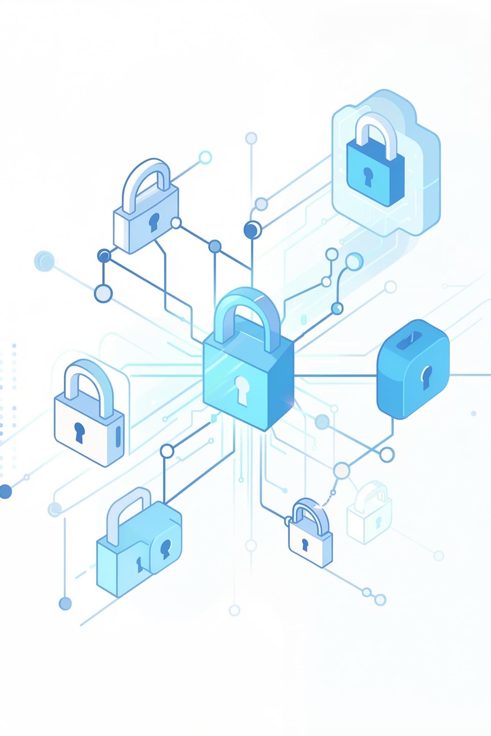
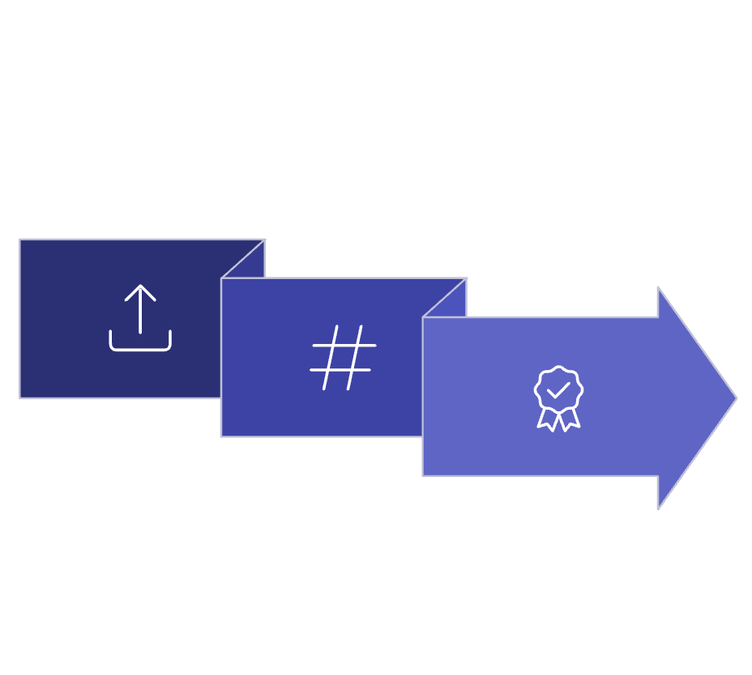
Impact Summary & Project Outcome
End-to-End Verification Outcome Flow
Upload Certificate
Employer Validation
Verify Hash
Fast, secure credential validation.
Key Project Outcomes
Tamper-Proof Vault
Zero-Trust Verification
Immutable document storage.
No central intermediaries.
Authenticity Proof
Instantly flags fake credentials.

Slide 16

Scope of the Project
Secure storage of digital documents using IPFS.
Blockchain-based document verification.
Smart contract-enabled access control.
Decentralized Identity (DID) based authentication.
Tamper-proof audit trail for all document transactions.
Secure document sharing among users, institutions, and organizations.
.

Slide 17
Literature Survey
Research Work | Contribution | Limitation
Bitcoin: A Peer-to-Peer Electronic Cash System (2008) | Introduced blockchain and decentralized consensus | Focused only on cryptocurrency
Decentralizing Privacy using Blockchain (2015) | Proposed user-controlled personal data | Did not address document management
W3C Verifiable Credentials (2019) | Standardized digital credentials | No decentralized storage architecture
Hyperledger Fabric Documentation | Enterprise-grade permissioned blockchain | Requires consortium management

Slide 18
Research Gap
Existing Systems
-Depend on centralized storage.
-Vulnerable to single-point failures.
-Limited interoperability across organizations.
-Lack user-controlled access to documents.
-No immutable audit trail.
Proposed Solution
-Decentralized blockchain architecture.
-User-owned document management.
-Smart contract-based access control.
-IPFS for decentralized document storage.
-Immutable blockchain-based verification and auditing.

Slide 19
Feasibility Analysis
-Technical Feasibility
Uses mature technologies such as Ethereum/Hyperledger Fabric, IPFS, React.js, Node.js, and Solidity, making implementation technically feasible.
-Economic Feasibility
Open-source blockchain frameworks and IPFS significantly reduce software and infrastructure costs.
-Operational Feasibility
The system provides an easy-to-use interface for citizens, institutions, and organizations with minimal changes to existing workflows.
-Legal Feasibility
Digital signatures and electronic records are supported under the Information Technology Act, 2000, enabling future legal adoption.
-Schedule Feasibility
The project can be successfully completed within a semester following a phased development approach.

Slide 20
References
1. Satoshi Nakamoto, Bitcoin: A Peer-to-Peer Electronic Cash System, 2008.
2. Government of India, DigiLocker Official Documentation.
3. Ethereum Foundation, Ethereum Documentation.
4. Hyperledger Foundation, Hyperledger Fabric Documentation.
5. IPFS Documentation – Protocol Labs.
6. W3C, Verifiable Credentials Data Model 1.1.
7. Zyskind, Nathan & Pentland, Alex. Decentralizing Privacy: Using Blockchain to Protect Personal Data, 2015.

Slide 21
Conclusion & Call to Action
Why Blockchain-Based Digital Document Locker?
Fixes DigiLocker gaps
User-owned and controlled
Proof of authenticity
Instant verification
Stronger security and privacy
Key Takeaways:
1
DigiLocker has security and privacy gaps. Blockchain closes them.
2
Blockchain makes records tamper-proof and trustworthy.
3
We combine trust, control, and speed in one system.
4
Users get full control with instant verification.
Call to Action:
To build secure, decentralized document storage.

